Slide 1
Frequency and Correlation Analysis of Risk Tags
By Akhil Devarasetty

Slide 2
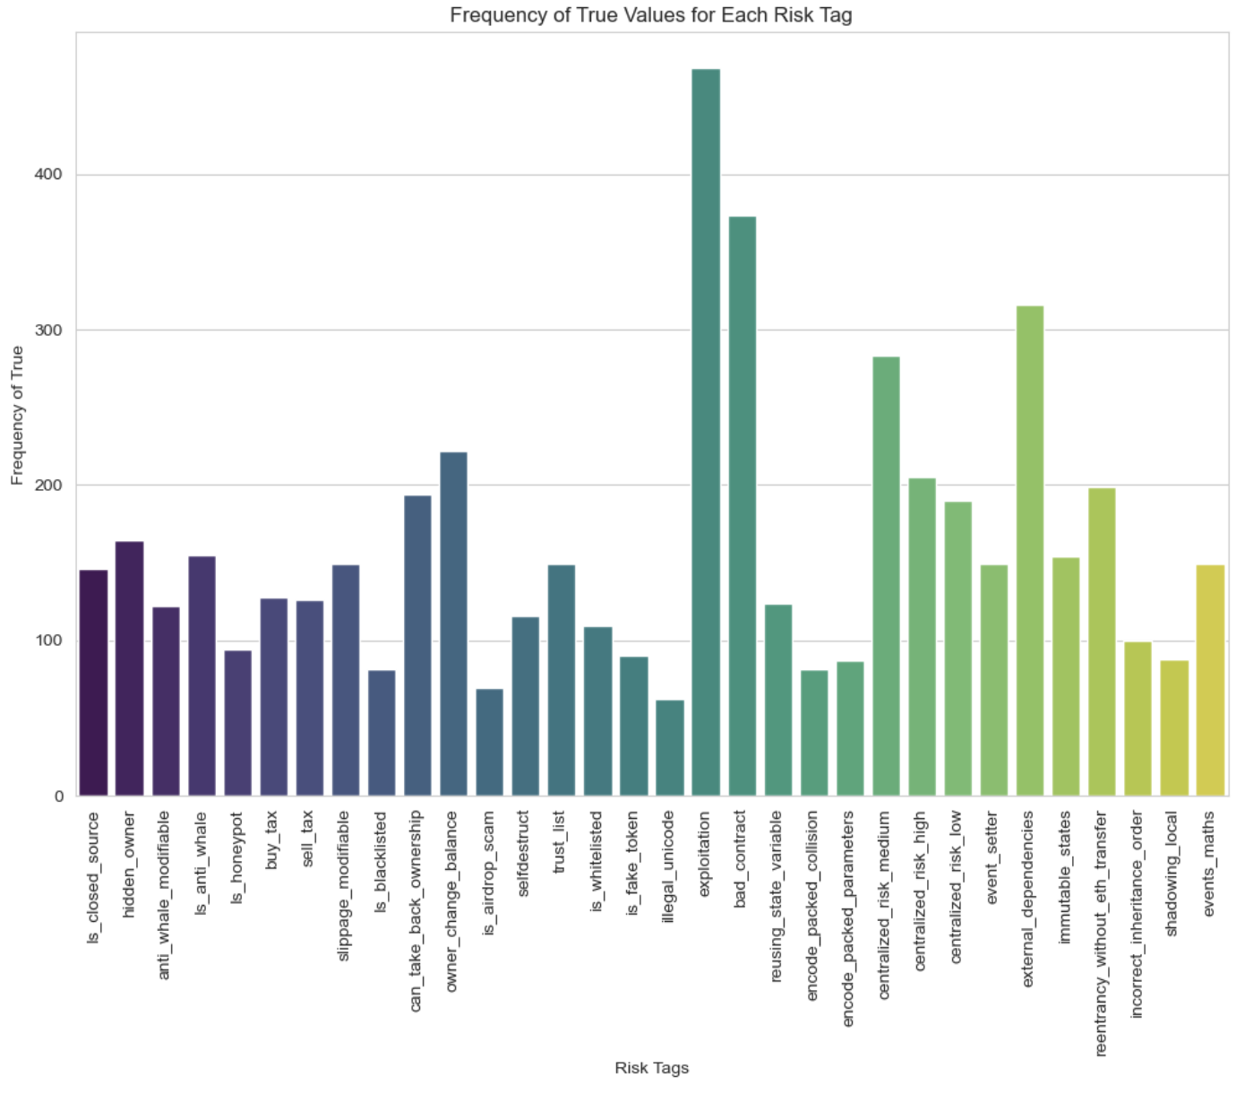
Risk Tag Frequency Chart

Slide 3
Most Common Risk Tag
The most common risk tag is exploitation at 468 counts
Most bad actors and other security risks would act upon exploitations when breaking through security.
Companies usually find the exploit and create some sort of patch to fix it

Slide 4
Surprising Risk Tag Frequencies
The most surprising risk tag is is_airdrop_scam at 69 counts
I did not expect it to be as high as it is
I think lack of information on what people are expecting to receive has bumped this number higher

Slide 5
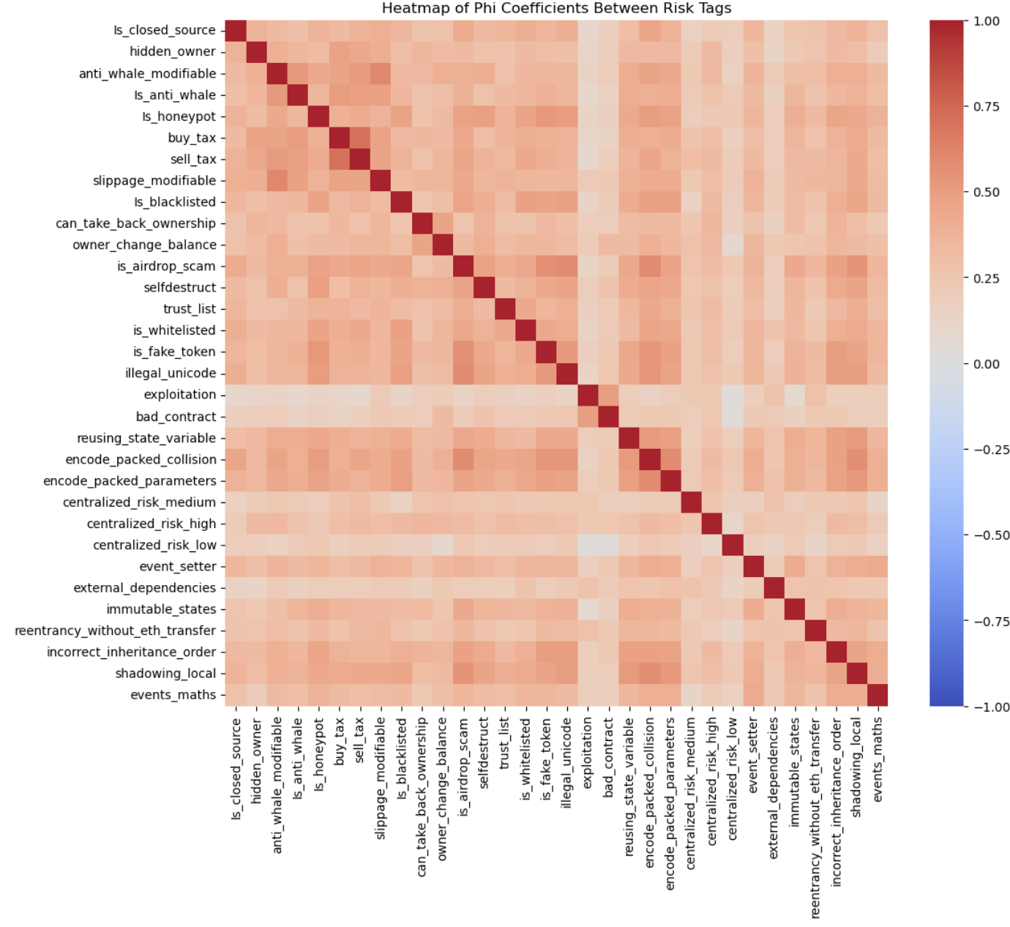
Risk Tag Correlation Heat Map

Slide 6
Phi-Coefficient: hidden_owner and is_airdrop_scam
≈ 0.3333851547550887

Slide 7
Complementing Risk Tags
illegal_unicode and is_airdrop_scam at 0.5868934027871914
They both have similar use-cases
They are both used in phishing attacks

